Slide 1
Wilderness therapy
Person-In-Environment
Mindfulness
Eco wellness therapy
Nature therapy
Horticulture therapy
Gardening as Therapy
Adventure therapy
Systems theory
Fungi / mycobacterium
Sensory benefits to health-related recovery
By
Daniel
Oladokun-Dybowski, LMSW
Shinrin Yoku / forest bathing

Slide 2
The Hohokam were the first stewards of the land
It is important to recognize
that the first farmers were (and are) the
indigenous people to this region.
Archaeological evidence of their
vast knowledge of the landscape
is indisputable. It is fact, written in
the soil.
Modern canals are superimposed
over theirs, mirroring their engineering
expertise and understanding of the
natural landscape.

Slide 3
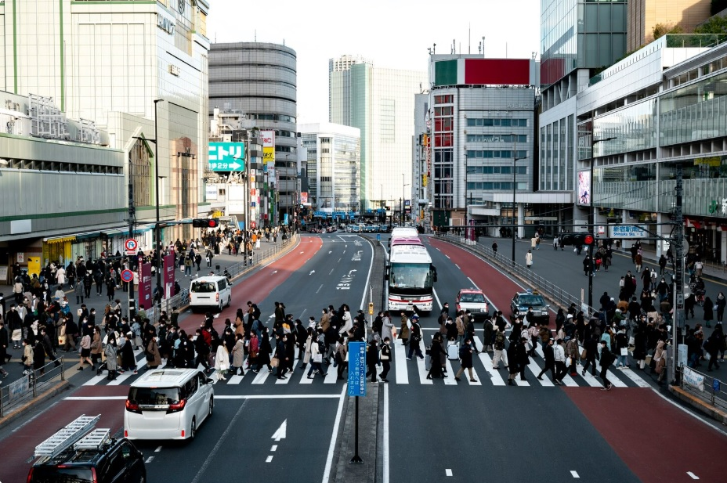
Times change, and “progress” only grows more pavement

Slide 4
Nature therapy and Shinrin-Yoku
Popularized in Japan, “forest-bathing”, or Shinrin-Yoku, can lower your cortisol levels, and increase dopamine and serotonin produced within your brain to render a positive euphoric effect to help lower blood pressure and reduce stress from anxiety, panic attacks, depression, etc.
Masanobu Fukuoka was a philosopher who popularized “natural farming,” which is a slow return to basics removing humans from natural processes returning the landscape to food abundance where humans do less and nature does more.

Slide 5
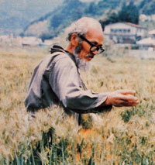
Natural farming:
Grow more plants
Masanobu Fukuoka was a nature-
based philosopher who asked us to
return farming to its natural state.
He learned how we can remove the human from the equation.
Less human intervention is better.

Slide 6
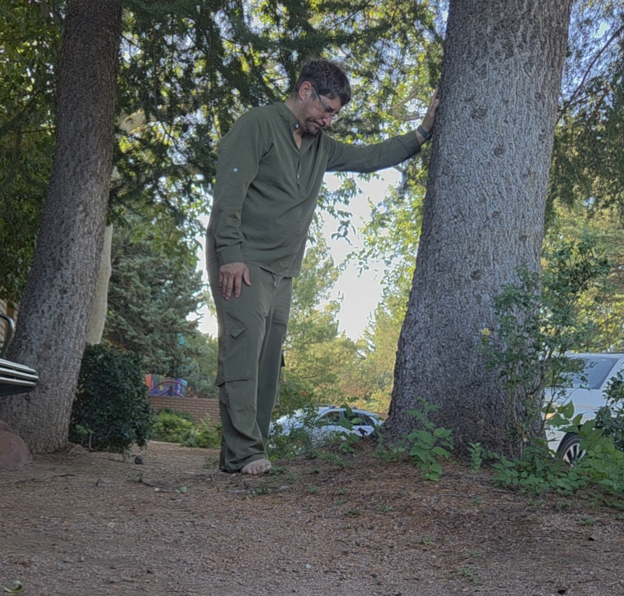
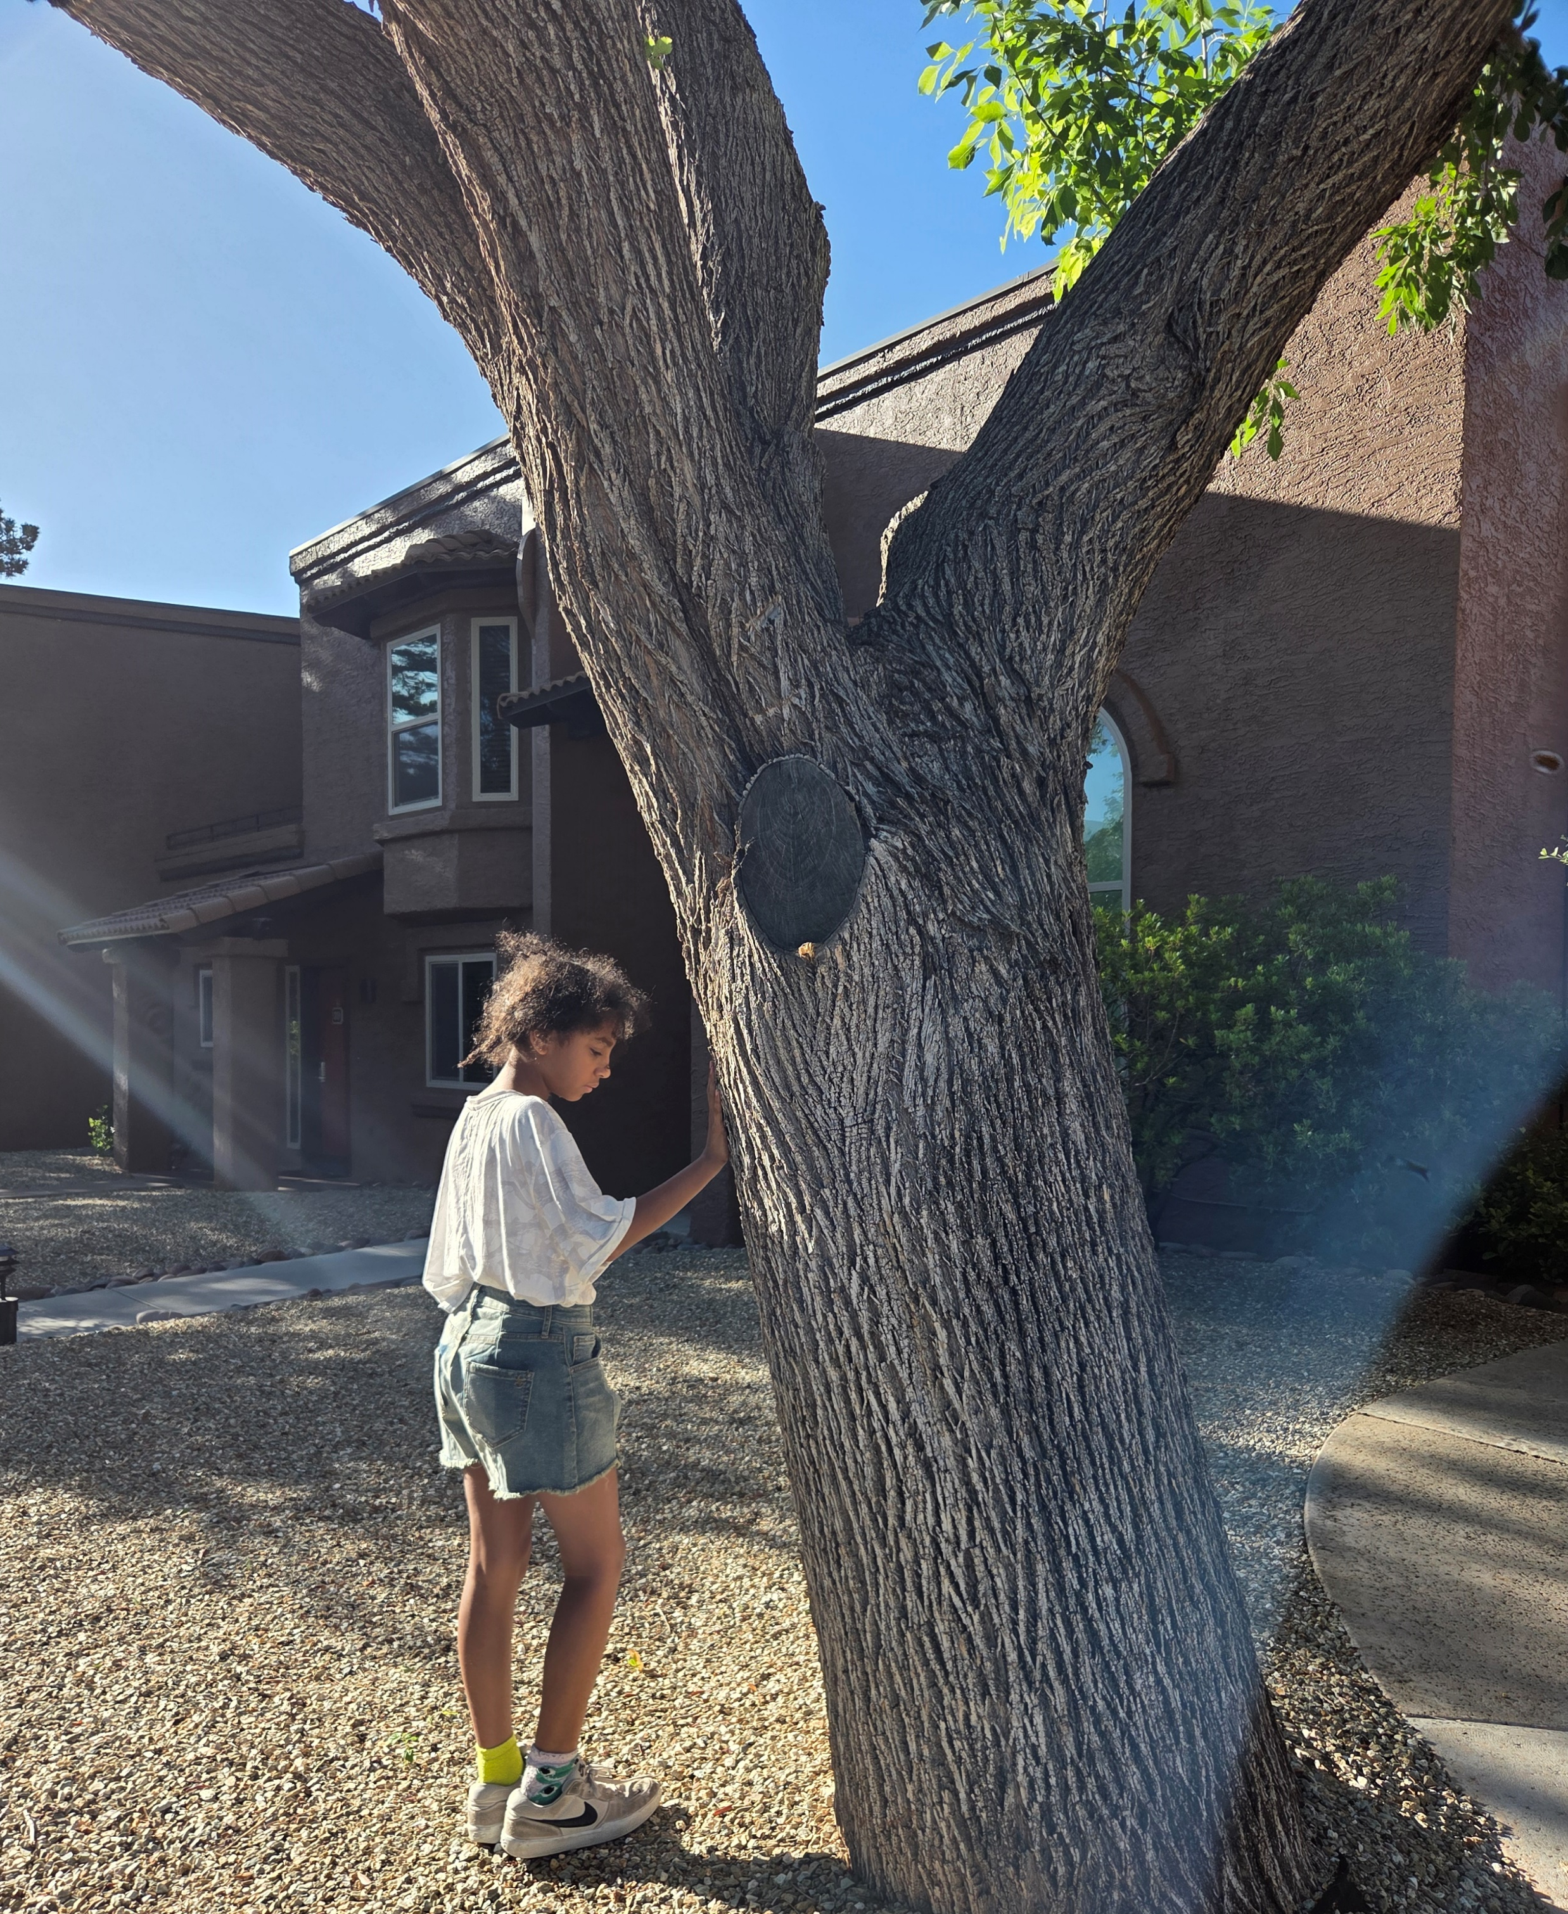
Rejuvenating with phytoncide exposure

Slide 7
Can a garden be the same as the wild?
Absolutely! If you customize your therapeutic garden to attract wildlife (birds, pollinators, insects) then you can experience everything the outdoors has right in your own back or front yard.
The essential oils from trees and plants can enter your bloodstream with the natural dopaminergic “phytoncides” produced by the tree's response to external stimuli.

Slide 8
Can gardening heal?
Absolutely! Gardening can calm the nervous system, overstimulate the senses, boost mood through exposure to beneficial soil bacteria.
https://youtu.be/Hi2j3Evq76o?si=pWFvWB6AEFItMom5
A dopamine rush occurs when the brain produces serotonin and dopamine due to contact with tree, and soil microbes within the soil.

Slide 9
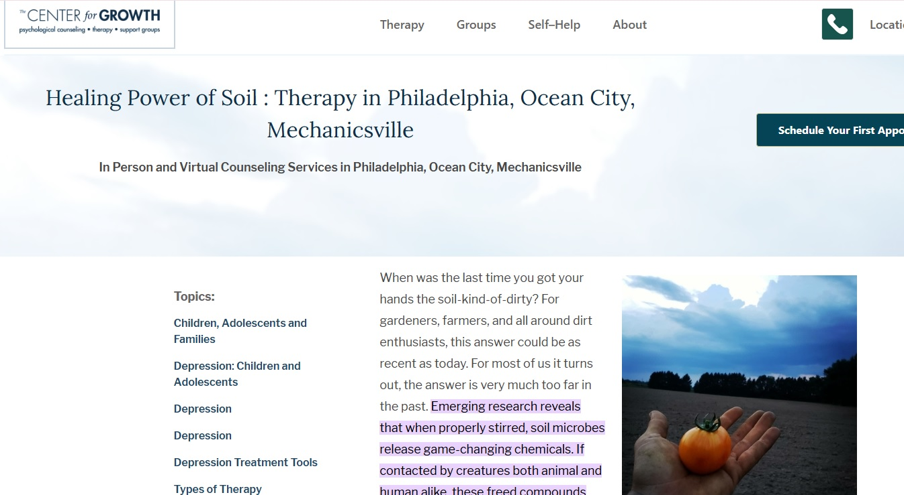
Healing Power of Soil https://thecenterforgrowth.com/tips/the-healing-power-of-soil#:~:text=Emerging%20research%20reveals%20that%20when,is%20known%20to%20boost%20mood.

Slide 10
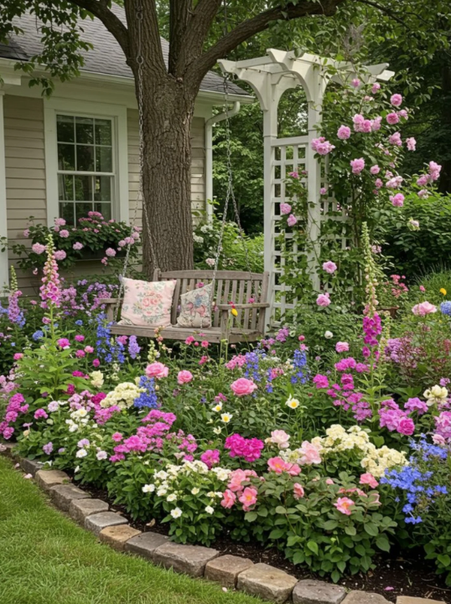
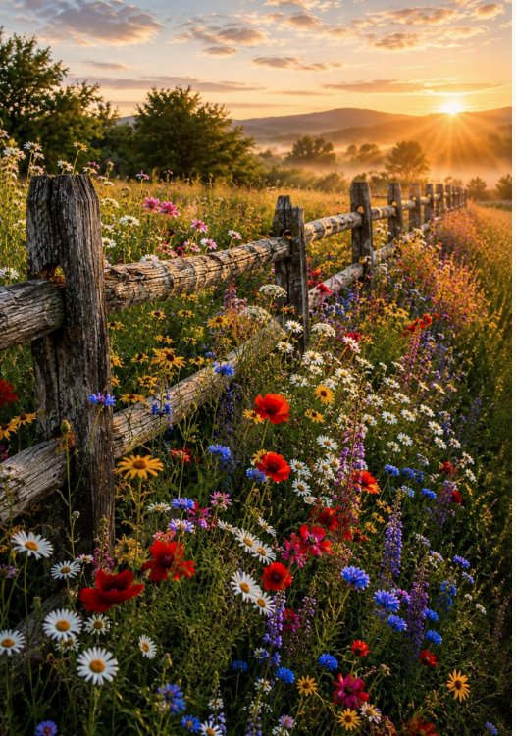
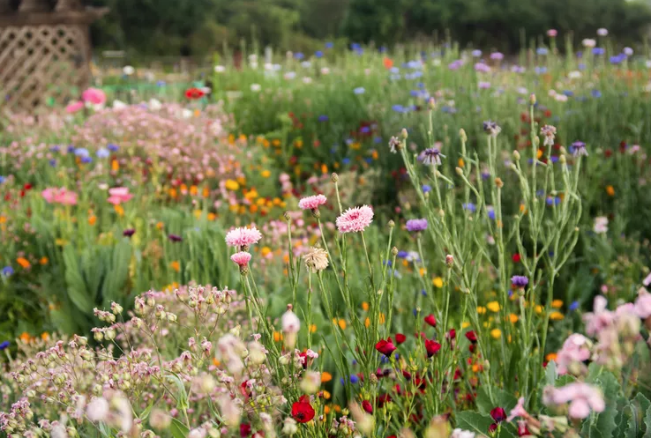
Color also has a healing effect on the mind

Slide 11
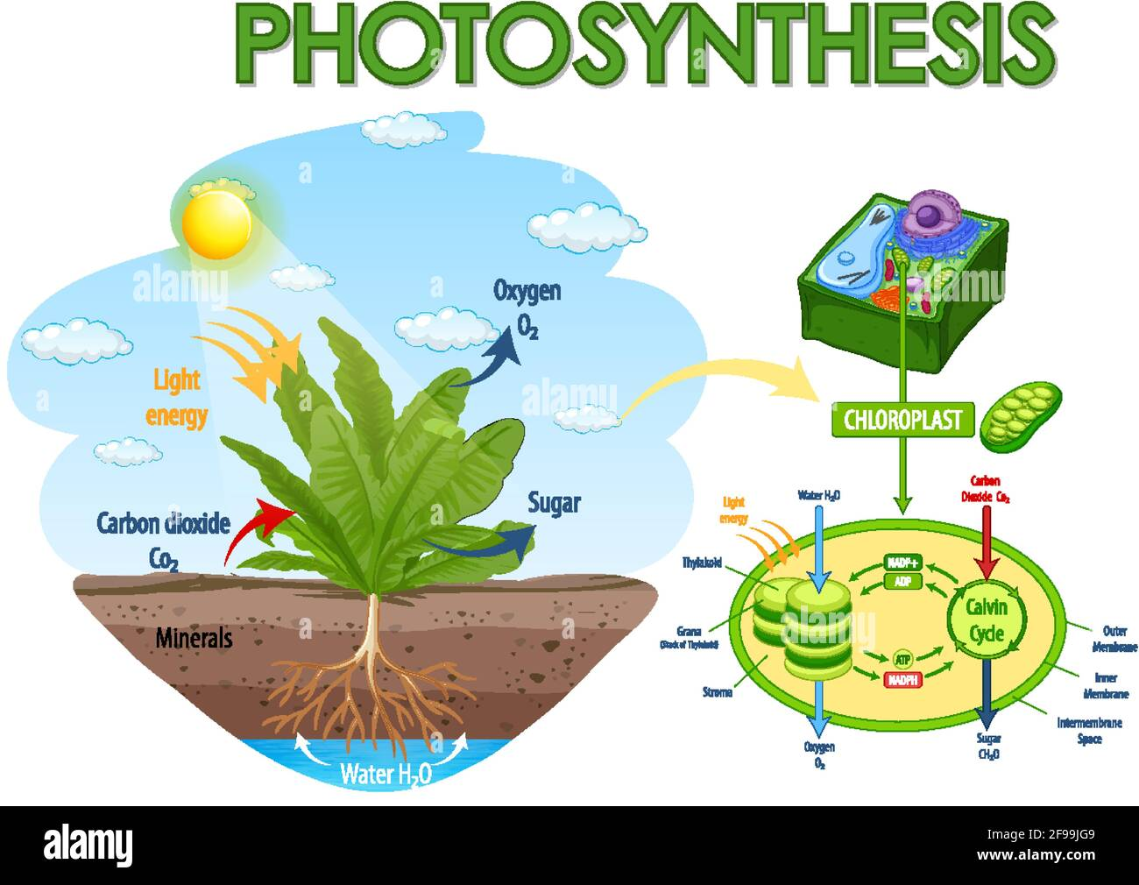
Symbiosis: humans rely on plants to produce oxygen and plants rely on us to produce carbon dioxide
Together:
we make a pretty good team

Slide 12
Sensory rich gardening elements
Touch (tactile): ranging from the soft leaves of mullein, to sticky creosote.
Smell (olfactory): fragrant herbs like rosemary, lavender, creosote, and sweet bush stimulate the senses.
Sound (auditory): Each plant has a sway or reaction to wind and draws in distinct pollinators to its flowers to create an auditory stimulus to the human ear.
Sight (visual): Vibrant colors to the various shades of green heighten our awareness in our visual stimulus.
Taste (gustatory): Each edible plant tastes differently and is adopted for specific culinary cuisine.
Power (mindfulness): The human mind’s sense for creativity in the utilization of certain plants for medicinal purposes, or cuisine, or ancient knowledge of which toxic plants are to be avoided or utilized for ceremonial purposes.

Slide 13
Therapeutic benefits
Stress reduction and mindfulness: The immersive qualities of placing oneself in a situated perspective within the environment and engaging in the elements with listening to the birds, observing the pollinators, feeling the plants, the heat on your skin, and smelling the flowers - all lowers anxiety.
Cognitive and motor skills: Gardening enhances focus, memory, it reinforces cultural lifeways and indigenous practices, it exposes the youth to sensory learning environment which reinforces information tapping into different neurocircuitry that a standard theater style classroom setting might not be able to.
Emotional well-being: Cultivating plants boost confidence and self-esteem through the sense of accomplishment.
Accessibility: Sensory gardens can be designed in multiple ways, but to beautify an area, attract wildlife, and exponentially grow abundance to build a seed-currency to share with others, and spread the seed-wealth.

Slide 14
Symbiosis
Humans rely on plants for survival, and plants rely on humans.
We exhale carbon-dioxide, and plants eat this component, along with sunlight, minerals in the soil, and moisture wicked up from the roots to form glucose for the plant to eat through photosynthesis.
We benefit from the foliage and the oxygen produced and released from the stomata under the leaves.
Without plants, humans cannot exist.
Now think of what climate change is doing to our global ecosystems and how we might be able to take part in reversing it.

Slide 15
Mindfulness use Outdoors
Visceral reaction to plants (indoors and outdoors)
More “Less Screen Time More Nature Time” (Harris, Linnea, 2026).
  “People are just craving that connection to the land, getting away from the screen, and developing this deeper appreciation of the natural world around them.”
Some plants that have beneficial hormones (phytoestrogens like isoflavones and resveratrol)
  Aloe vera, pomegranate, green tea, and ginseng (ginsenosides)
In the book “Chatter”, Dr. Ethan Kross explains that spending time in green spaces like gardens is a powerful tool to quiet the negative inner voice. He refers to this as utilizing "active rest" to regulate mental states. He also referred to a seminal study that stated even a view outside of a window to greenspace increases healing potential in patients in healthcare settings (referring to this study Ulrich (1984.)

Slide 16
Christian Faith-based therapy
Into the Wilderness: https://www.youtube.com/watch?v=F6sxHXkBB18
The Bible mentions “wilderness” over 300 times, which is often used symbolically for difficult, challenging, for uncertain periods in life, representing a time of testing, temptation, and spiritual growth.
The Wilderness is the exact place God has led you to.
The wilderness is isolating, where faith is tested (James 1:2-4.)
The wilderness tests you, mentally and physically.
The wilderness feels alone, desolate, and tempting.
Depleted in every way, our spirit is tested.
Summary: The “wilderness” can be a place for learning and healing.

Slide 17
The economics of gardening therapy
For those who want to learn how to budget, why not begin with seeds by changing the unit of analysis from money to seeds?
Seeds can be propagated exponentially through active seed harvesting, saving, and storing properly in ‘cool/dark/dry’ places.
This ancient knowledge fueled the agricultural revolution where seeds were currency long before money or ‘coinage’ ever became the modern form of monetary currency we now know.
One can teach clients how to maximize their return on investment with little to no effort, but by employing the power of nature into their scheme at exponentially multiplying seasonal seed stocks, even while working a normal work day away from the garden.

Slide 18
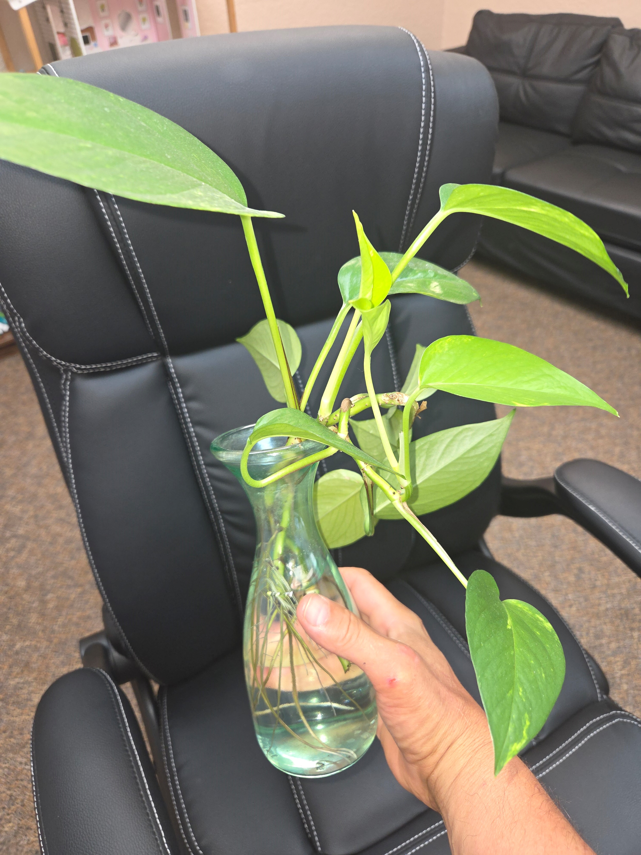
Indoor plants can enhance moods in an office
Studies have shown that having an
indoor plant in your office can
significantly enhance one’s mood.
It demonstrates life, and care,
nurturing, provides oxygen, and
purifies the air of toxins.
Propagating cuttings in water
encourages conversations on
multiplying plants at no cost.

Slide 19
Into the Wild
Although tragically unprepared, the story of Chris McCandless points to an inner-drive, motivation, and youthful vigor that can be gained from something innate within us all which is the need for more outdoors to be integrated into our lives.
The need for more nature is a craving, and with less nature around us due to overpopulation, growing pavement, displaced landscape due to over-farming, or solar fields, our ability to have access to the “Great Outdoors” is becoming harder.
Chris McCandless sadly perished, but his story is one of needing to get outdoors and making a big decision to venture into the unknown.
As therapists, we can tap into this hidden latent power and use it to heal others.

Slide 20

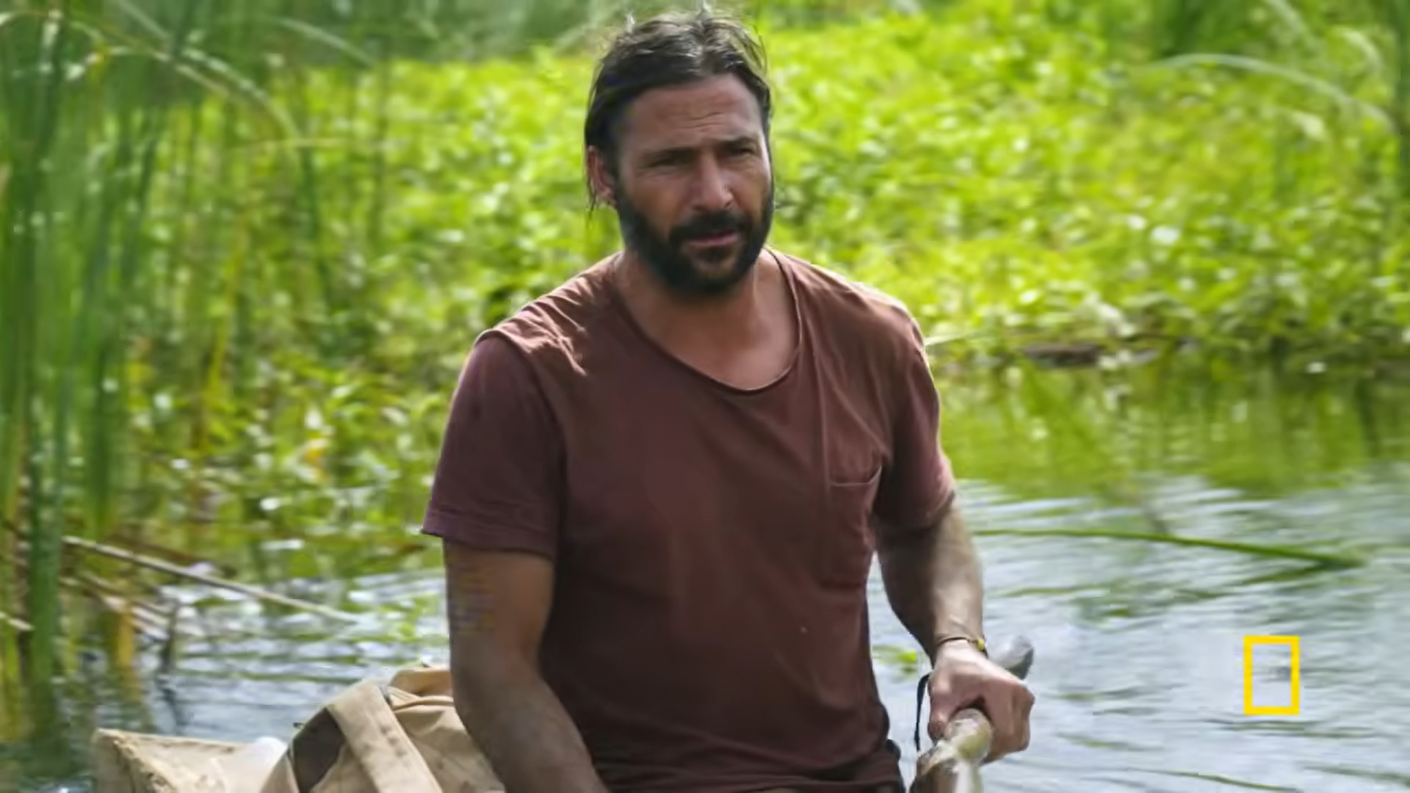
Bush-crafting
Some people are popularizing on National Geographic a return to the great outdoors online and through Patreon accounts: https://www.hazenaudel.com/

Slide 21
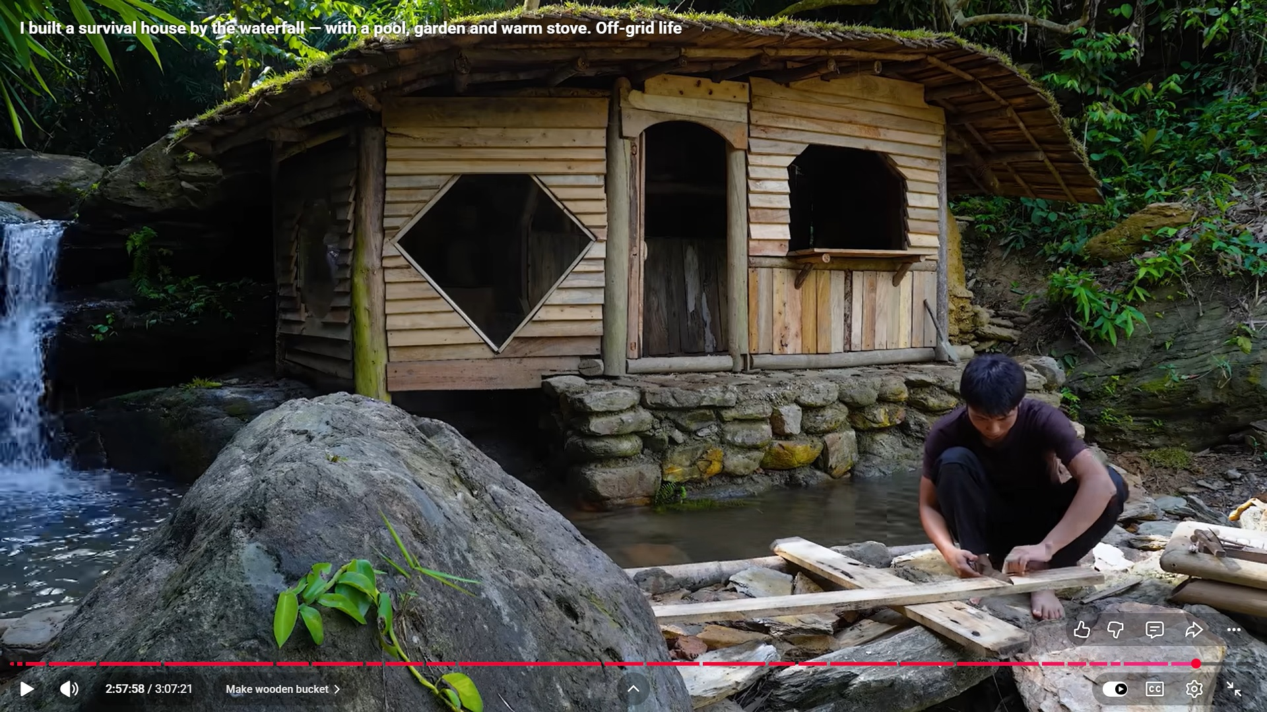
Bush-craft farm in Vietnam
There are many people using YouTube to demonstrate Bush-crafting, ancient skills, integrating both adventure therapy, gardening therapy, and shinrin yoku into living in nature and working with nature, such as this young man in Vietnam: https://www.youtube.com/@BushcraftFarm1
ASMR (autonomous sensory
Meridian response): our brain
responds to sounds, moving
water, visuals of moving fish,
and other calming effects
within a natural setting.

Slide 22

The S.P.A.R.T.A. Project
https://www.thespartaproject.org/
Dedicated to helping trauma survivors, veterans, and first responders, overcome some of life’s most difficult challenges, The SPARTA Project focuses on using wilderness adventure courses along with psychiatry and therapy to help people victimized by traumatic thoughts in beginning their brave new journey toward recovery.
SPARTA uses meditative and Mindfulness practices integrated into their therapeutic nature modalities to help clients recover in their own time.

Slide 23
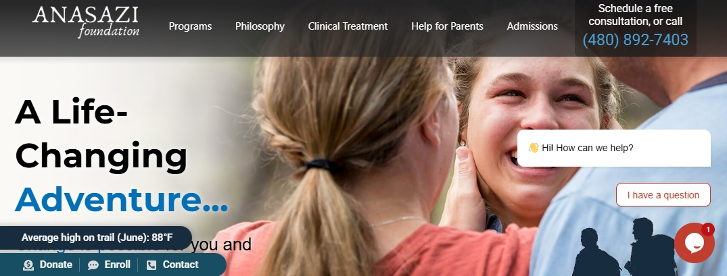
Anasazi Foundation
https://anasazi.org/anasaziway/
A local wilderness based referral potential for a new therapy that brings the client to nature because the Anasazi Way is a way of “walking” in the wilderness and in life, as the website describes.
The Anasazi Foundation is based in Mesa, Arizona and have been bringing families closer together since 1988.
At the core of this practice is “nature” again.

Slide 24
Wilderness Adventure therapy
Developed by Simon Crisp (Crisp, 1997, 1998, Noblet, & Hinch, 2004)
Uses adventure-based models in the outdoors to stimulate response to challenges to direct clients in perseverance with self esteem.
Group facilitators help clients process their feelings in this wilderness-based setting while going through challenges overcoming obstacles both mental and physical.

Slide 25
Local wilderness-based therapy references
Anasazi.org (based in Mesa, Arizona) https://anasazi.org/
Back2Basics recovery https://back2basicsrecovery.com/our-program/outdoor-adventure/
Sierra Tucson https://www.sierratucson.com/therapies/integrative/adventure/
St. Joseph's Hospital and Medical Center: Features a massive, one-acre Healing Garden
Mayo Clinic Nature Trails and Gardens
Banner University Medical Center (Phoenix): The hospital features a patient-centered Healing Garden
Scottsdale Healthcare Thompson Peak Hospital: The campus features beautifully designed outdoor spaces with drought-tolerant plantings, hummingbird and butterfly gardens
Carl T. Hayden VA Medical Center has multiple therapeutic garden

Slide 26
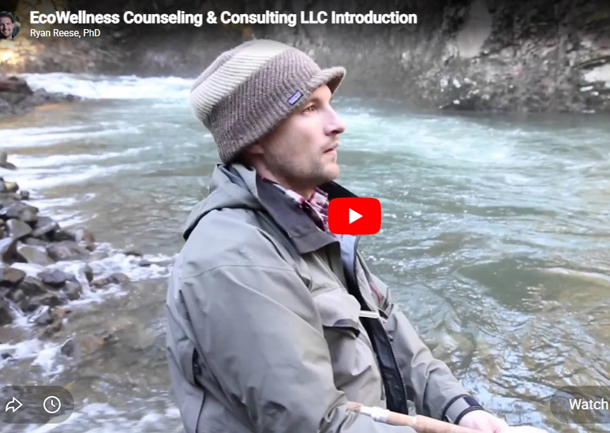
Eco wellness therapy models
Dr. Ryan Reese in Oregon (Eco Wellness) https://ecowellnessbend.com/
Child counseling and parent coaching
Adolescent issues and transitioning into adulthood
Persistent and/or Major Depression
Grief
Stress & Anxiety
Trauma
Life purpose/existential issues
Work-life balance
Difficult life transitions
Relationship challenges

Slide 27
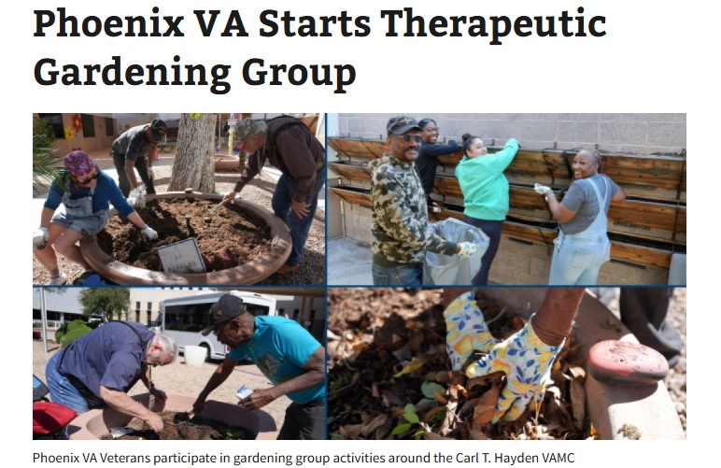
https://www.va.gov/phoenix-health-care/stories/phoenix-va-starts-therapeutic-gardening-group/

Slide 28
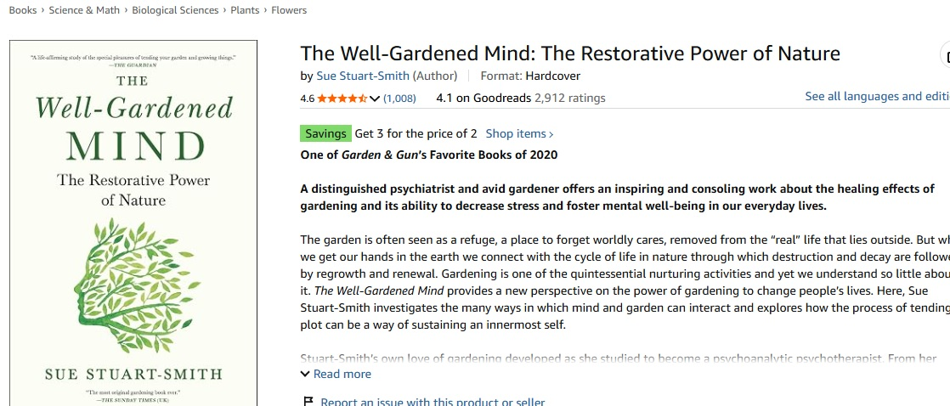
Our connection to nature is backed up by neuroscience as Dr. Sue Stuart-Smyth discusses in How Gardening Heals the Mind. https://youtu.be/3FRlmiOuSfs?si=0hgbF3anMC8fkSAW

Slide 29
Integrating Gardening Therapy into a Tx Plan
Gardening can teach patience, empower clients to be resilient, improve self-esteem, stimulate motivation, allow people space to talk about their experiences, enable people to recover and heal from trauma, and liberate the senses while simultaneously healing from natures natural healing properties.
An example Tx Plan goal would be:
  Client wants to learn coping skills in an outdoor setting to open up and speak about his feelings, express himself more openly with others, and explain himself to others without fear of rejection. Exposure to outdoor nature therapy will help the client access thoughts and open up the therapist in an outdoors setting.
    The client will use gardening therapy to help him express his feelings with dual-modality of CBT and gardening therapy in practice. The client’s present measure is a 1 or 2 out of 10 with 10 as the highest ability to express himself.
    The client wants to be more of a 8 or 9 on the Likert scale.

Slide 30
More Tx plan ideas
For veterans with TBI, culture shock, or PTSD
  Working in the garden provides peace, serenity, calmness, lowers cortisol levels, and exposes the client to a litany of senses overwhelmed by scent, movement, color, and tactile sensations to calm physiology. When alone with your thoughts, or guided by a therapist, the mind connects with a more spiritual aspect of connection to Earth.
    The client wants to reduce elements of PTSD, and culture shock with sudden reintegration into civilian society with the outdoor experiences offered by shinrin yoku. The therapist will used CBT in the client’s forest-bathing experience in an outdoor setting.
      The client is presently an 8 out of 10 with 10 being the highest amount of anxiety related to trauma, and stress of reintegration back into civilian life and society.
      The client wants to be a 2.

Slide 31
More Tx plan ideas
The sensory rich environment can stimulate the imagination with the senses overwhelmed by sight, taste, touch, smell, and hearing all of what the outdoors environmental setting has to offer.
  A child with Autism and ADHD will work with the therapist in an outdoor environment to help them learn coping skills using shinrin yoku to help them stay focused, learn core skills in an outdoor setting to become more focused and become more motivated to want to learn more about the biological sciences.
    The client is presently a 0 out of 10 with 10 being the highest amount of motivation and focus.
    The client wants to be more of an 8.
        All goals are negotiated over time in family therapy sessions.

Slide 32
More on Tx planning
A client wants to improve confidence in self by learning how to overcome challenges with propagating plant cuttings.
  The client will learn how to root rosemary and sweet potato cuttings and build confidence in self with ability to provide life to plants.
    The client is at a 0 out of 10 with 10 being the highest confidence.
    The client wants to be at least a 5.
      The outdoor experience is a change of office, a change of pace, and change of atmosphere.

Slide 33
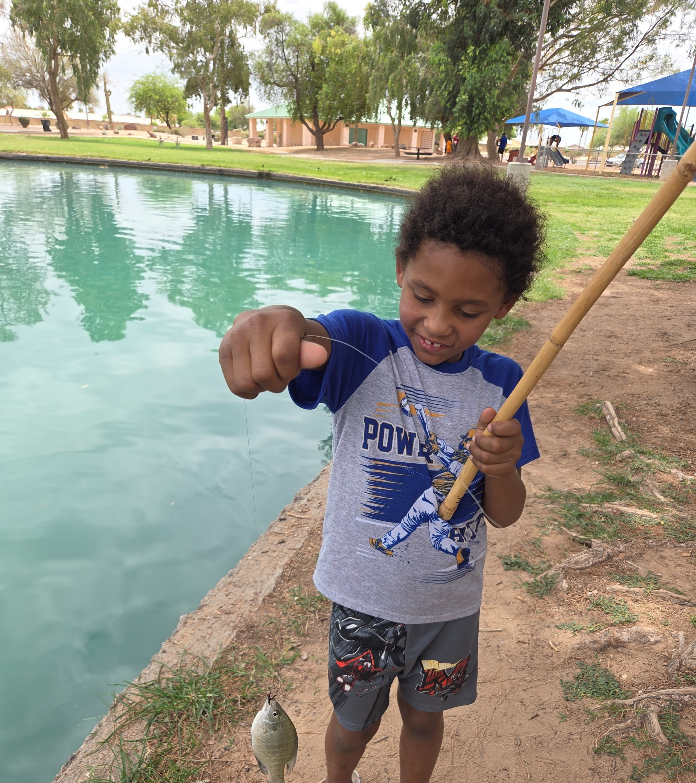
Planting seeds on day one
By handing a client a packet of seeds on day one, and on every subsequent meeting, the client becomes empowered to begin this developmental journey.
To see the eyes of a client light up when they see a sprout is akin to a child catching a fish for the first time, or shall I say - like a fish catching a child.
Some seeds will grow, but some will not. Focus on the ones that grow. This is like focusing on the positive over negative thoughts.
“Stay in the solution and the problem will die of neglect.”

Slide 34
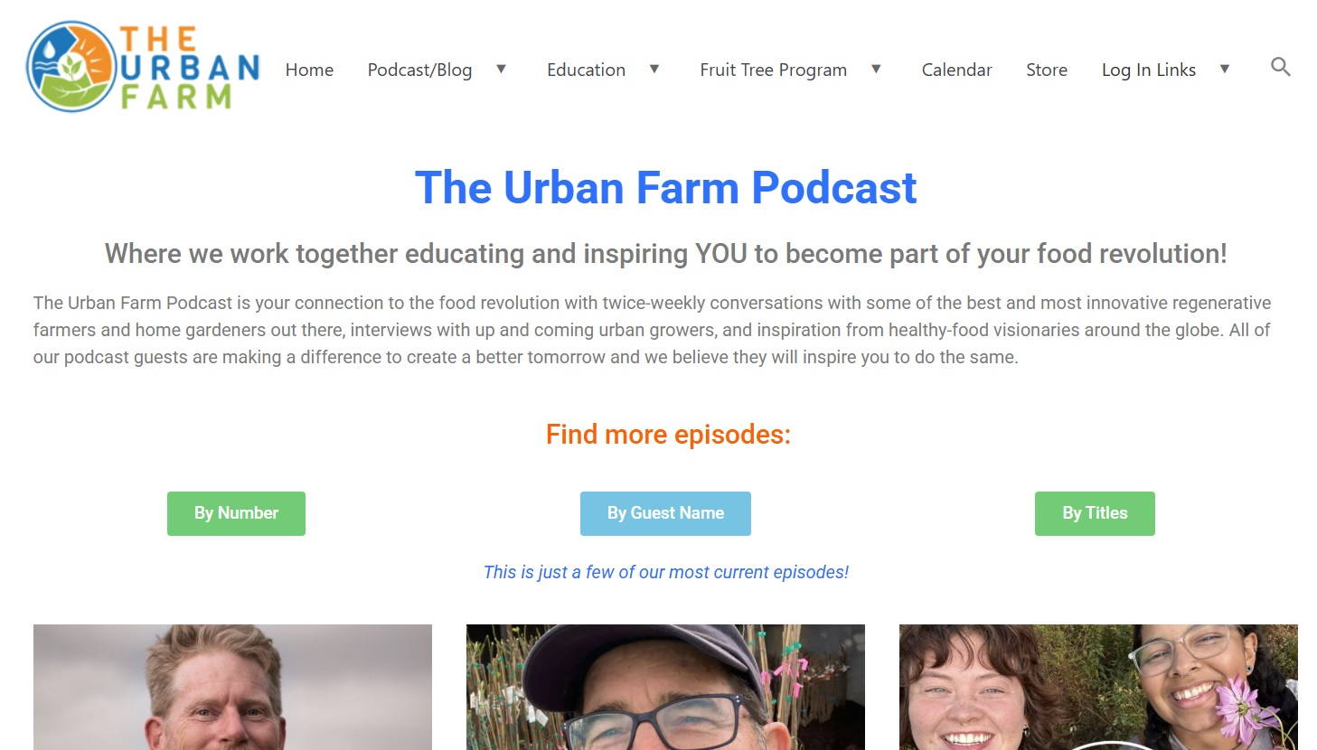
How can therapists build their own gardening skills?
1. Join a free gardening group
and self-educate.
2. Plant some seeds.
3. Learn about photosynthesis
and carbon sequestration.
4. Begin an experimental garden
with your own family.
5. Contact your local Agricultural
Extension or NRCS office or
local library.
6. Visit a free seed/garden stand
and socialize with neighbors.

Slide 35
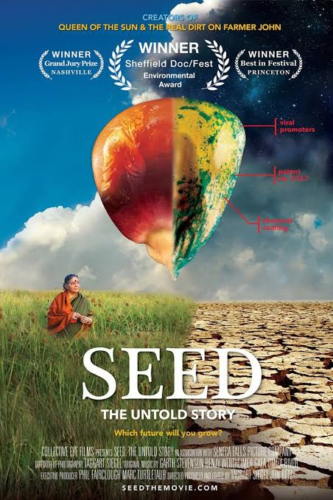
The solution:
Grow more plants
Plant a seed, plant a tree. Save all of your seeds and build your seed-currency by giving them away to others.
When you positively impress others with growing, you grow awareness regeneration, and rebirth, which is all hopeful.
This documentary creates awareness about where out food comes from and how important it is to focus on saving our seeds.

Slide 36
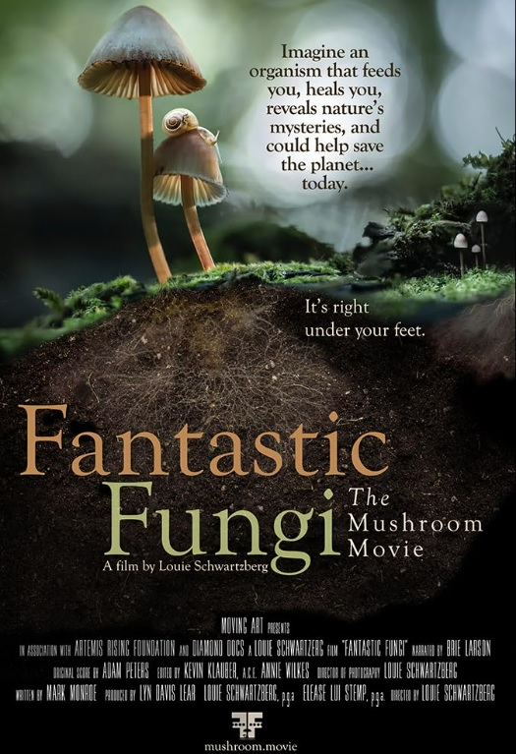
Fungal diversity:
Grow more plants
When we each grow more plants, we create a
habitat that brings back the birds, the
pollinators, and other biodiversity too
numerous to mention.
When I began growing a food forest in my own
yard, I realized I was changing the soil structure
over time, and a dense mat of mycelium was
forming to create a ecological phenomenon
known as the “Wood Wide Web.”
Plants communicate their needs to other plants.

Slide 37
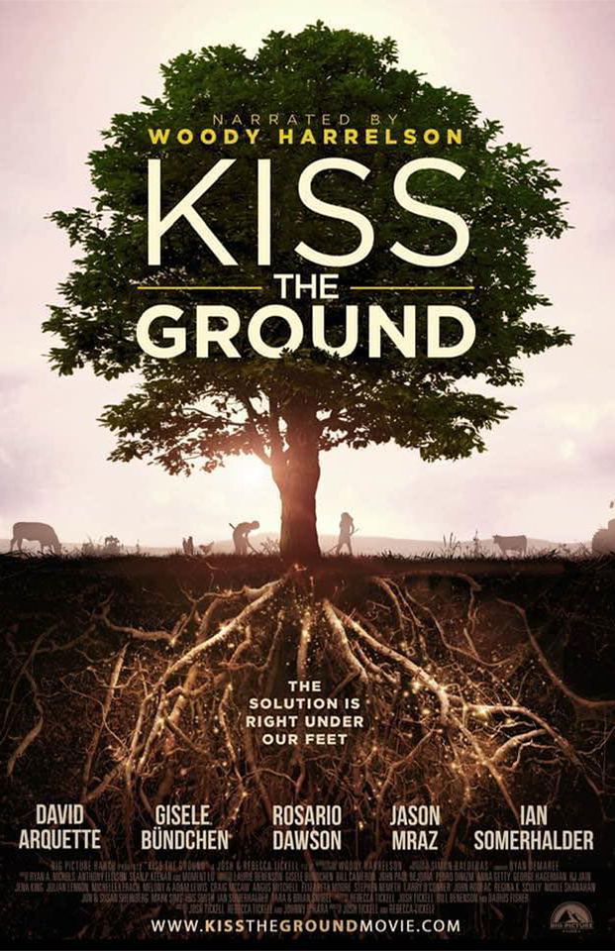
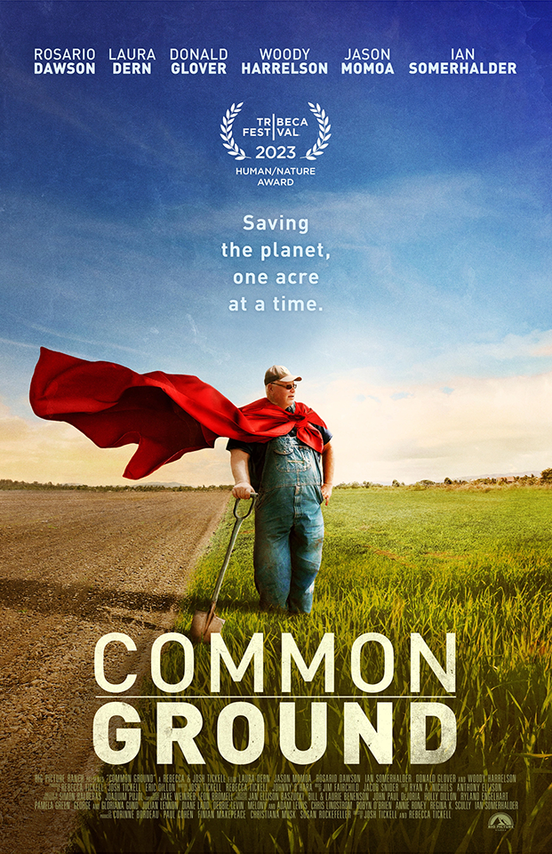
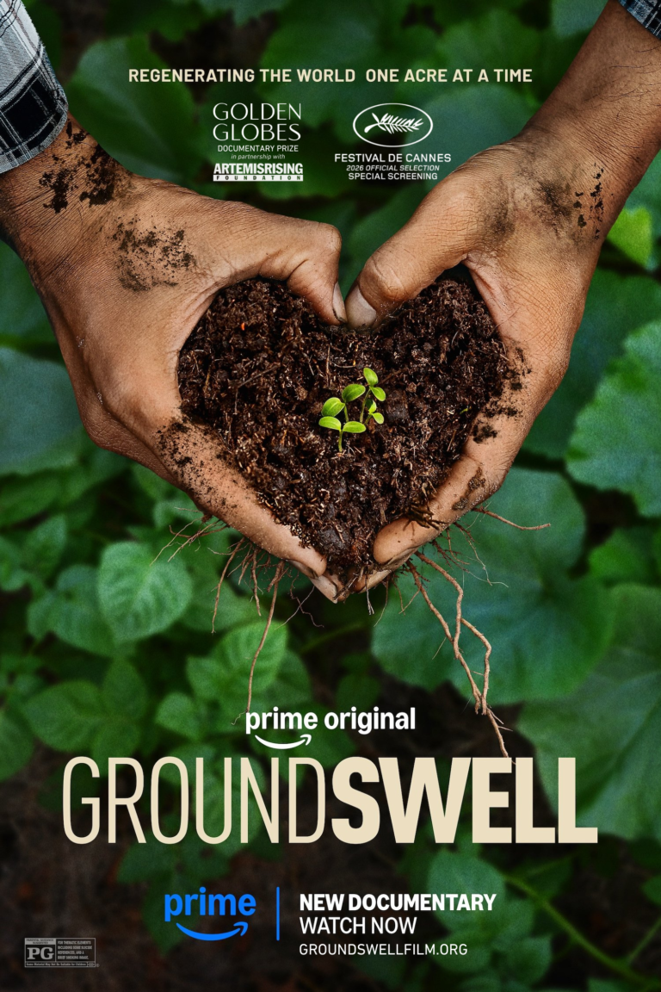

Slide 38
Micro-Mezo-Macro based awareness
The importance of learning how to use gardening as a latent power source for the human spirit is at the core of gardening therapy at an individual level.
Social workers can contribute to bolstering local food supplies with a mezo-level/group task force where community organizing is needed.
Gardening as therapy has even broader impacts in communities and cities through local habitat restoration programs or macro-level political intervention with social work advocacy for food-security and community garden access for a broader base of citizens.

Slide 39
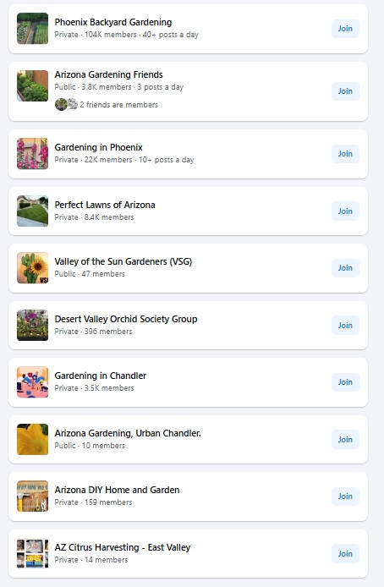
Ways to connect in your community.
There are a growing number of people who crave learning how to grow their own food online, as exemplified by the growing number of online gardening groups.
People are beginning to realize our connection to the Earth, and the need to pay less at the grocery store but invest more in our own homes.
Some reasons for growing food are due to increased concerns about diseases E-Coli, Lysteria, and Cyclospora are but a few recent recalled item concerns.

Slide 40
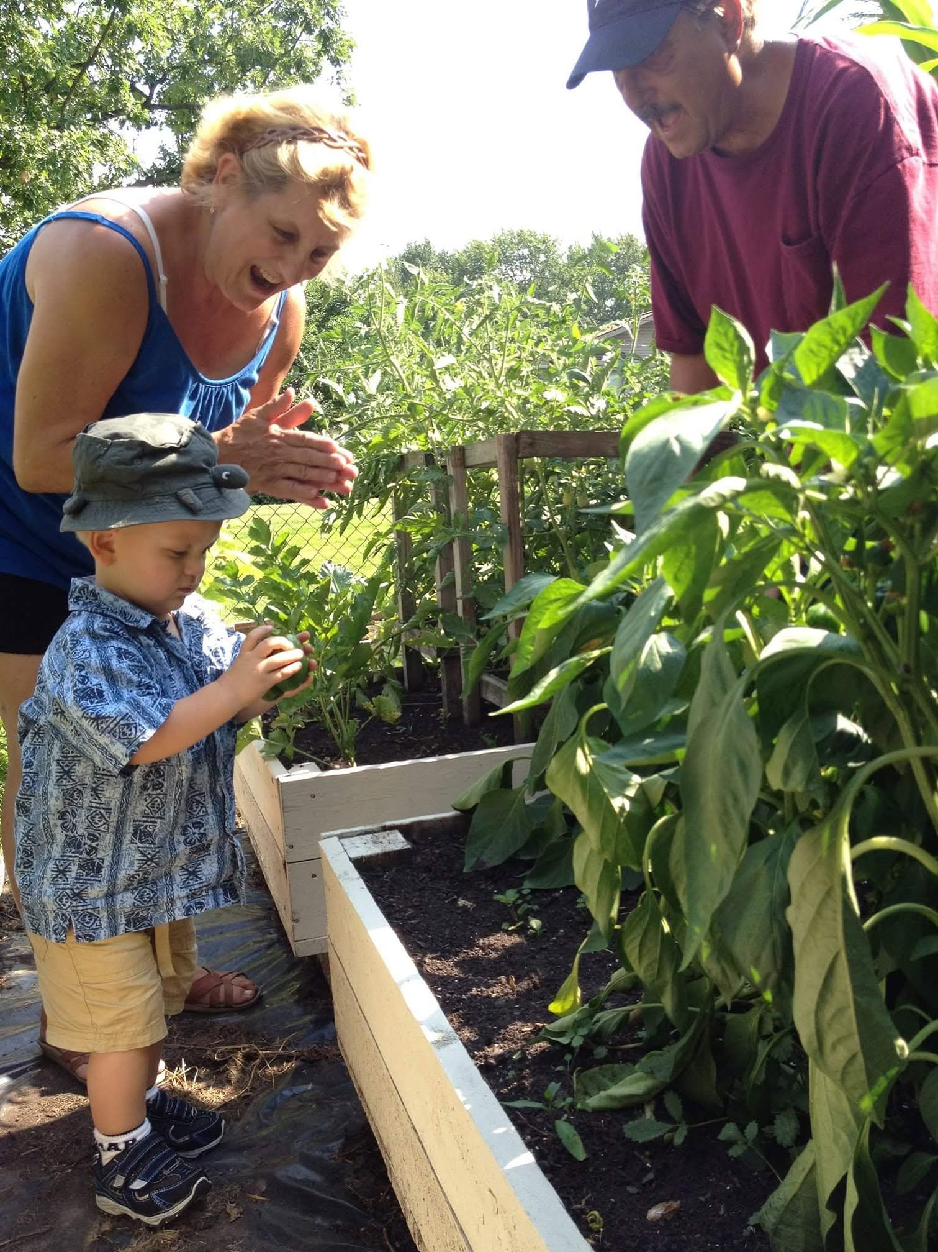
Families who grow together, grow together
When a family spends time in the garden
together, creating a shared space filled with lush vegetation,
the family can simultaneously build coping skills together
with mutual benefit.
At home gardens have been on the rise post-Covid,
in a “Victory Garden’s” like emulation due to the dearth
of seeds during Covid.
Seeds were hard to come by. Now, people are becoming
aware and creating real positive change in communities.
How else will be able to feed 8 plus billion people on
the planet unless we cultivate our own creative solutions to our
growing problem.
It all begins in the human mind, within the home.
Will you be a part of the solution?

Slide 41
Conclusion
Whatever your reasons are for utilizing gardening as a form of therapy, it will benefit you and client simultaneously.
CBT, DBT, CPT, Mindfulness, and other therapeutic modalities can be used simultaneously in a change of setting.
Privacy can be kept if settings are conditioned and built for privacy.
Be sure to remain mindful of HIPAA standards, NASW Code of Ethics, and client-centered and family-centered focused first when conceptualizing integrating gardening therapy into your practice modalities.

Slide 42
Contact
Daniel Oladokun-Dybowski, LMSW
dybowskimsw@gmail.com
To obtain a copy of these slides, you can email me with the subject header:
“Gardening is Therapy”

Slide 43
Bibliography
Apanovich, N., King, G. O., Limbaugh, A., Smith, G., & Bernal, S. (2025). Socio-cultural benefits of an urban agriculture initiative designed for vulnerable populations in Tucson, Arizona. Journal of Agriculture, Food Systems, and Community Development, 14(3), 123–140. https://doi.org/10.5304/jafscd.2025.143.022
Addressing Food Insecurity with School Gardens Presented by Brandon Merchant School Garden Education Coordinator. Website URL: https://azfoodbanks.org/wp-content/uploads/2024/04/Addressing-Food-Insecurity-with-School-Gardens.pdf#:~:text=Addressing%20Food%20Insecurity,Born%20and%20Raised%20in%20Arizona

Slide 44
Bibliography Pt 2
Aspinall, P., Mavros, P., Coyne, R., & Roe, J. (2015). The urban brain: Analyzing outdoor physical activity with mobile EEG. British Journal of Sports Medicine, 49(4), 252-256.
AGRITECTURE: Can Community Gardens Weaken Food Insecurity Issues?
Website URL: https://www.agritecture.com/blog/community-gardens-and-food-insecurity
Bearne, Suzanne (2026). From the barren shores to green oases: how a surfer looking for shade ended up transforming Costa Rica’s coastline. The Guardian.

Slide 45
Bibliography Pt 3
Benton TG, Castro de la Mata G, Fanzo J, Guinto R, Hendriks SL, Montgomery H, Myers S. Food security and health in a changing environment: Recognizing and mitigating risks. Doha, Qatar: World Innovation Summit for Health, 2022
Bowen, D. J., Neill, J. T., & Crisp, S. J. R. (2016). Wilderness Adventure Therapy effects on the mental health of youth participants. Evaluation and Program Planning. This foundational meta-analysis provides the primary empirical basis for short- and long-term improvements in psychological functioning. Read the full study via the PubMed Abstract or review the compiled data in the ResearchGate Publication. [1, 2, 3]
Carney, M. A., Hamada, J., Massie, J., Wakefield, S., & Johnston, C. (2012). Impact of a community gardening project on vegetable intake, food security and family relationships: A community-based participatory research study. Journal of Community Health, 37(4), 874-881. DOI: 10.1007/s10900-011-9522-z [1, 2]

Slide 46
Bibliography Pt 4
Crisp, Simon. (1998). International Models of Best Practice in Wilderness and Adventure Therapy. In: Exploring the Boundaries of Adventure Therapy. International Perspectives. Proceedings of the International Adventure Therapy Conference (1st, Perth, Australia, July 1997).
Crittenton, Anya (2026) GREEN AMERICA: Community gardens and food-security go hand-in-hand. Website URL: https://greenamerica.org/your-green-life-2026/community-gardens-and-food-security-go-hand-hand
Cookson, L. J. (2011). A Definition for Wildness. Ecopsychology, 3(3), 187-193.

Slide 47
Bibliography Pt 5
Faber Taylor, A., & Kuo, F. E. M. (2011). Could exposure to everyday green spaces help treat adhd? Evidence from children's play settings. Applied Psychology: Health and Well-Being, 3(3), 281-303. https://doi.org/10.1111/j.1758-0854.2011.01052.x
Food Security and Livelihoods: Partnering with Communities to Improve Food Security. Website URL: https://www.actionagainsthunger.org/our-solutions/food-security-livelihoods/
Ganann, R., Fitzpatrick-Lewis, D., Ciliska, D., & Peirson, L. (2012). Community-based interventions for enhancing access to or consumption of fruit and vegetables among five to 18-year olds: a scoping review. BMC Public Health, 12(711). [1, 2]

Slide 48
Bibliography Pt 6
Gillies, C., & Baay, C. (2025). Strengthening equity in gardening initiatives for children and youth: A rapid review. BMC Public Health, 25(1), Article 3981. doi.org [1, 2, 3]
Han, K.-T., & Ruan, L.-W. (2019). Effects of Indoor Plants on Self-Reported Perceptions: A Systemic Review. Sustainability, 11(16), 4506
Harris, Linnea (2026) Sierra Club. Ready for Less Screen Time and More Nature Time? Try WWOOFing. A Network of organic farms offers volunteers a chance to connect with the land, and one another. UR:” https://www.sierraclub.org/sierra/ready-less-screen-time-and-more-nature-time-try-wwoofing?utm_source=brevo&utm_medium=email&utm_campaign=SUBSCRIBER_EMAIL2_JUNE26&utm_id=36
Improving Food Access Through Community Gardens Website URL: https://let.umn.edu/sites/let.umn.edu/files/2022-10/policy_brief_8.pdf

Slide 49
Bibliography Pt 7
IPES-Food. (2017). Unravelling the food-health nexus. Global Alliance for the Future of Food; IPES-Food.
Li Q, Kobayashi M, Wakayama Y, Inagaki H, Katsumata M, Hirata Y, Hirata K, Shimizu T, Kawada T, Park BJ, Ohira T, Kagawa T, Miyazaki Y. Effect of phytoncide from trees on human natural killer cell function. Int J Immunopathol Pharmacol. 2009 Oct-Dec;22(4):951-9. doi: 10.1177/039463200902200410. PMID: 20074458.
Lew, T., et al. (2024). Phytoncides and immunity from forest to facility: A systematic review and meta-analysis. Pharmacological Research - Natural Products, 2, 100061. [1]
Editors: Malden C. Nesheim, Maria Oria, and Peggy Tsai Yih (2015). Authors: Committee on a Framework for Assessing the Health, Environmental, and Social Effects of the Food System; Food and Nutrition Board; Board on Agriculture and Natural Resources; Institute of Medicine; National Research Council. Washington (DC): National Academies Press (US); 2015 Jun 17. ISBN-13: 978-0-309-30780-2ISBN-13: 978-0-309-30780-5

Slide 50
Bibliography Pt 8
Merchant, Brandon. (n.d.). Arizona Food Bank Network. Addressing food insecurity with school gardens. https://azfoodbanks.org/wp-content/uploads/2024/04/Addressing-Food-Insecurity-with-School-Gardens.pdf
Myers, J. E., & Sweeney, T. J. (2008). Wellness counseling: The evidence base for practice. Journal of Counseling & Development, 86(4), 482-493. [1, 2]
Neff, Roni. (2014). Introduction to the U.S. Food System: Public Health, Environment, Equity.
Park, B. J., Tsunetsugu, Y., Kasetani, T., Kagawa, T., & Miyazaki, Y. (2010). The physiological effects of Shinrin-yoku (taking in the forest atmosphere or forest bathing): evidence from field experiments in 24 forests across Japan. Environmental Health and Preventive Medicine, 15(1), 18-26. DOI: 10.1007/s12199-009-0086-9

Slide 51
Bibliography Pt 9
Program Community Gardens. Health Care Without Harm (2026). URL: https://foodcommunitybenefit.noharm.org/resources/implementation-strategy/program-community-gardens-and-farms
Reese, R. F., & Myers, J. E. (2012). EcoWellness: The missing factor in holistic wellness models. Journal of Counseling & Development, 90(4), 400–406. https://doi.org/10.1002/j.1556-6676.2012.00050.x
Reese, Ryan & Myers, Jane & Lewis, Todd & Willse, John. (2015). Construction and Initial Validation of the Reese EcoWellness Inventory. International Journal for the Advancement of Counselling. 37. 10.1007/s10447-014-9232-1.

Slide 52
Bibliography Pt 10
REESE, RYAN F., Ph.D. EcoWellness: Construction & Validation of the Reese. EcoWellness Inventory. (2013). Dissertation Directed by Dr. Jane E. Myers. 379 pp.
SANTO, RAYCHEL, ANNE PALMER, BRENT KIM (2016) Vacant Lots to Vibrant Plots. URL:
https://clf.jhsph.edu/sites/default/files/2019-01/vacant-lots-to-vibrant-plots.pdf
Social Needs Investment Lab: https://healthbegins.org/wp-content/uploads/2024/10/Community-Gardens-Evidence-Assessment.pdf

Slide 53
Bibliography Pt 11
Sonya, Agaezi & Matthews, Eric. (2025). The Community Garden Perspective on Reducing Food Insecurity and Health Disparities. 10.21203/rs.3.rs-6609892/v1.
Stuart-Smith, S. (2020). The Well-Gardened Mind: The Restorative Power of Nature. Scribner.
Sweet, Cory etal. (2020) Addressing Food Insecurity: Expanding Access through Community Gardens. Website URL: https://utia.tennessee.edu/publications/wp-content/uploads/sites/269/2023/10/W1021D.pdf

Slide 54
Bibliography Pt 12
Ulrich, R. S. (1984). View through a window may influence recovery from surgery. Science, 224(4647), 420-421. DOI: 10.1126/science.6143402
Unruh, A. M., & Hutchinson, S. L. (2011). Embedded spirituality: gardening in daily life and stressful life experiences. Scandinavian Journal of Caring Sciences, 25(3), 567-574.
Wakefield, S., Yeudall, F., Taron, C., Reynolds, J., & Skinner, A. (2007). Growing urban health: Community gardening in South-East Toronto. Health Promotion International, 22(2), 92–101. [1]

Slide 55
Bibliography Pt 13
Watchorn, Roger (2025). CARGILL: Why resilient supply chains, farmers are essential for feeding our growing world. Website URL: https://www.cargill.com/story/feeding-growing-world-food-system-resilience?utm_source=search&utm_medium=paid&utm_campaign=feeding10b&gad_source=1&gad_campaignid=23709311478&gbraid=0AAAAADmS0VvOcQ2nFvHM2-zFDCeuQQuks&gclid=CjwKCAjwq6DQBhBVEiwA4ZD5XNecwFlTspxXWH3asNw8OEvtpmUvstXcDynbCDQLdM8xFGZ-RRiIhxoCp4IQAvD_BwE
Wentworth, Chelsea & Arroyo, Mariana & Lembi, Rafael & Feingold, Beth & Freedman, Darcy & Gray, Steven & Hodbod, Jennifer & Jablonski, Becca & Janda-Thomte, Kathryn & Lemoine, Pablo & Nielsen, Aida & Romeiko, Xiaobo & Salvo, Deborah & Schmitt Olabisi, Laura & Berg, Alexandra & Yamoah, Owusua. (2024). Navigating community engagement in participatory modeling of food systems. Environmental Science & Policy. 152. 103645. 10.1016/j.envsci.2023.103645.

